Slide 1

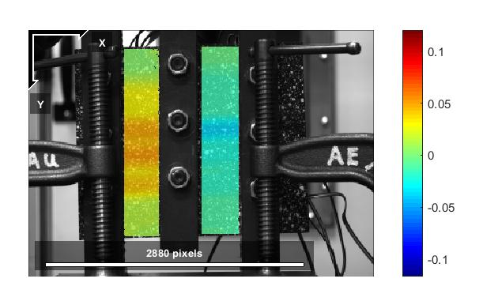
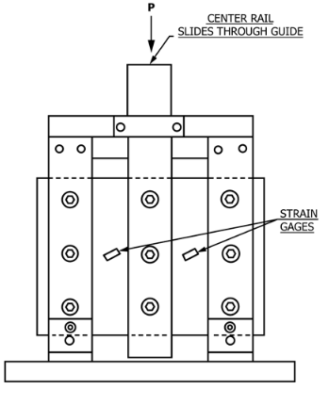
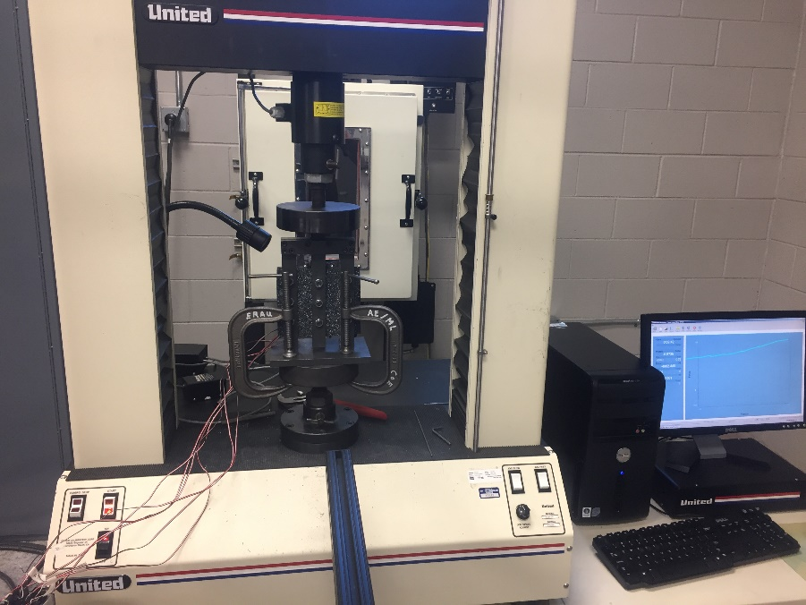
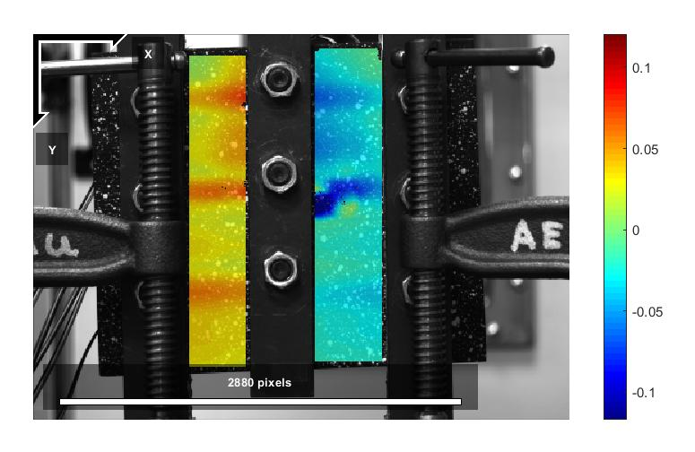
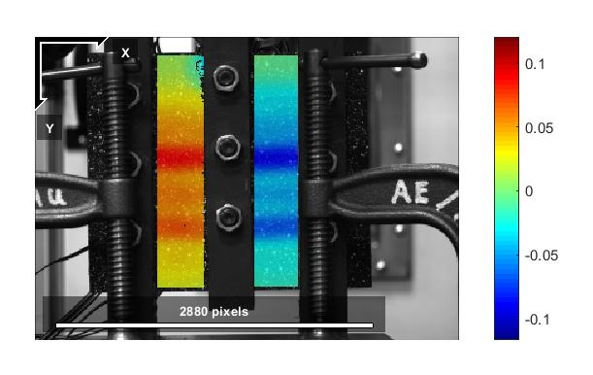
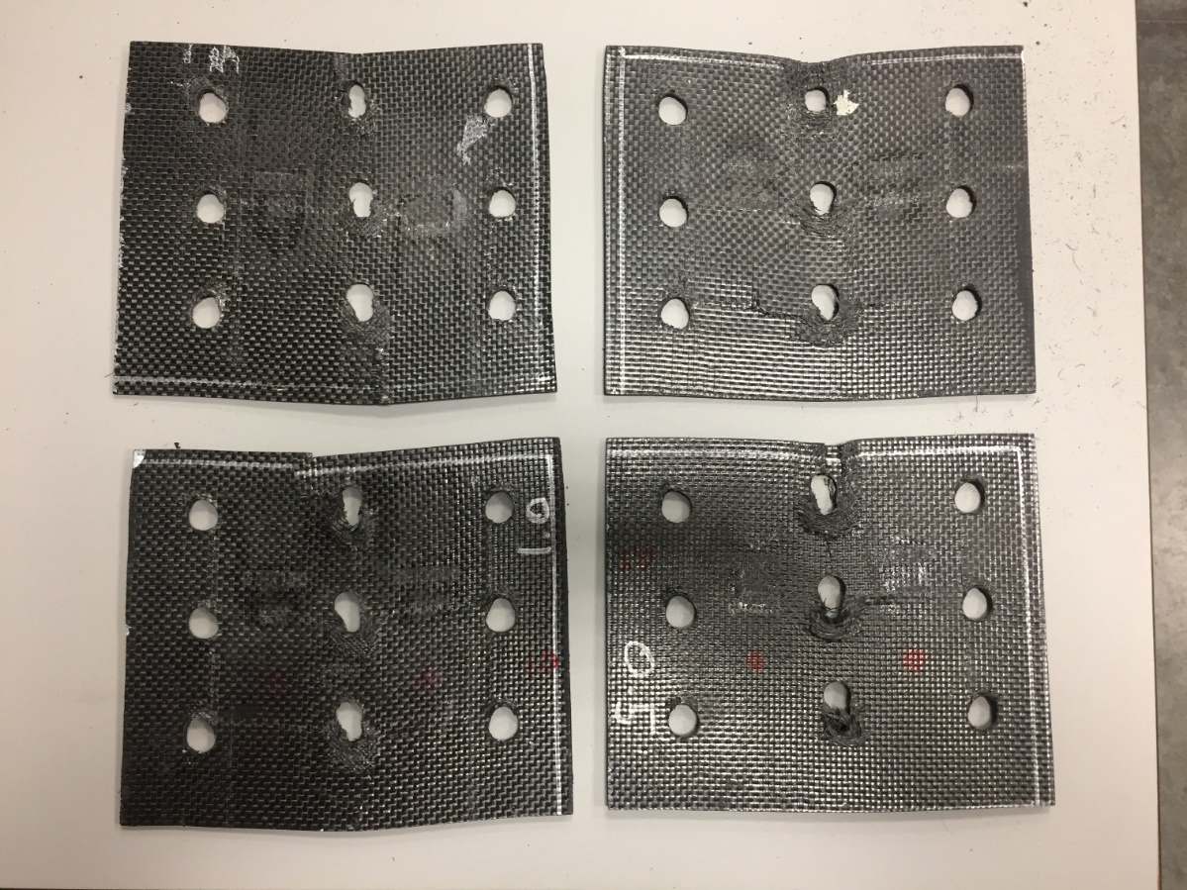
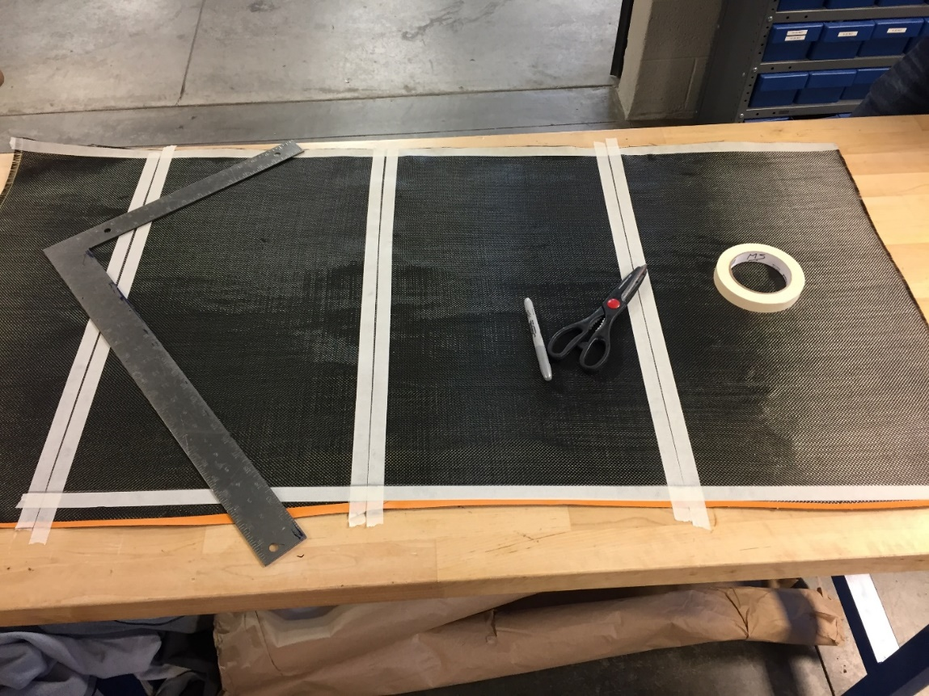
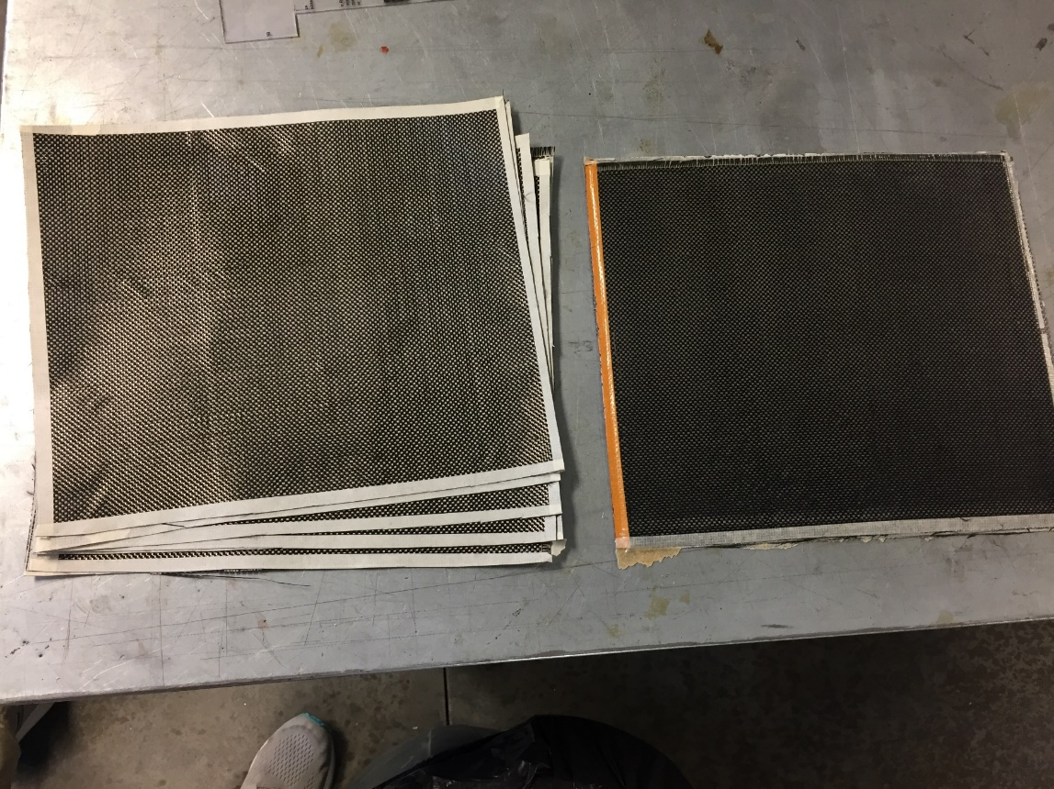
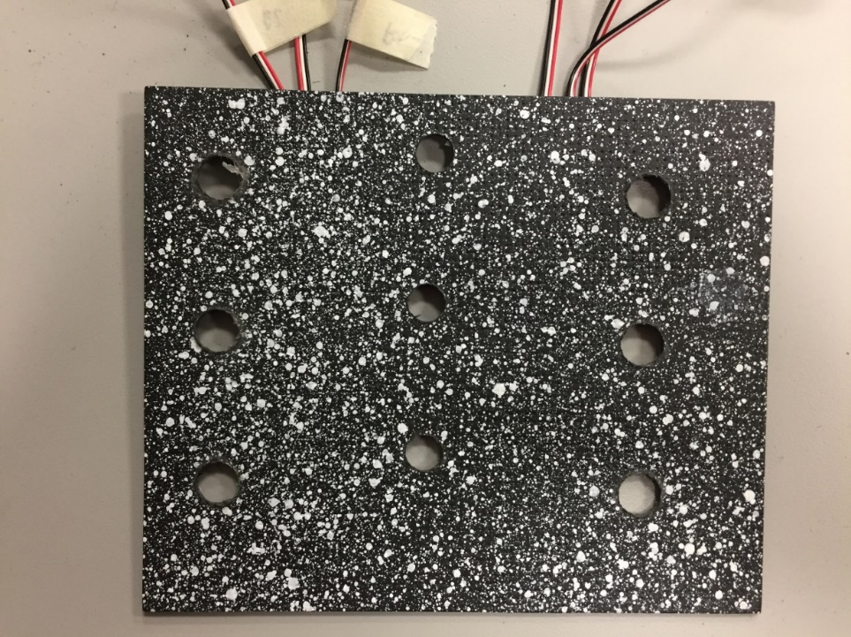
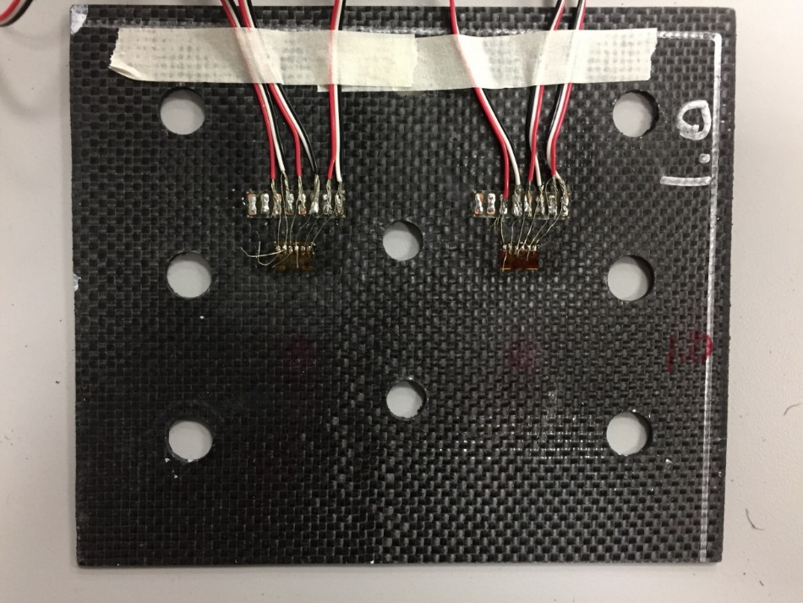
Experimental Study on Compression and Shear Strength of CFRP
Mentor: Dr. Wahyu Lestari, Aerospace Engineering Department, College of Engineering | Joseph Gentile, Aerospace Engineering Department, College of Engineering | Ethan Garber, Aerospace Engineering Department, College of Engineering
Abstract
Testing
Shear Strain Results
The increasing use of carbon fiber-reinforced polymer (CFRP) in the aerospace industry requires a better understanding of its damage properties. Many modern aircraft under high loads are utilizing this material for their primary structures due to its high strength to weight ratio. However, CFRPs are sensitive to out-of-plane loading such as low-velocity impact and indentation. These damages can reduce the compressive strength significantly without leaving a visible mark on the surface, which is known as Barely Visible Impact Damage (BVID). The behavior and residual strength of CFRPs after impact damage under compressive loading are still not fully understood. The purpose of this research is to use Digital Image Correlation (DIC) to study the failure mechanism and better understand the shear properties of CFRP after impact. To study the trend in CFRP damages, a series of shear tests with different impact levels will be performed. The strain values from the DIC method will be validated by conventional measurement using strain gauges that will be collected concurrently.
The damages applied to each sample were done by dropping a round metal rod from two different heights of 0.5 feet and 1 foot. These impacts had energies of 0.709ft-lb and 1.417ft-lb respectively.
The testing setup included a hydraulic press, a three rail shear fixture, a camera, and the hydraulic press’ computer system recording the displacement and force applied.
Pristine 1
Pristine 2
0.5 foot drop
1 foot drop
Layup
The 3 rail compression shear fixture
The testing setup
Samples: Four samples were made, each measuring 5” x 6” (L x W) with a thickness of 8 plies.
Material: [0/45/0/45]_{s} AS4 Plain Weave 3K 5.7oz. The epoxy mixture was 3 parts resin to 1 part hardener. TenCate BT250 E-6 Resin.
Curing Cycle: The samples were first left at room temperature for seven hours. Then they were put into the oven where the temperature increased to 180 degrees F for eight hours.
The samples after testing:
Top left- Pristine 1
Top right- Pristine 2
Bottom left- impact from 1 foot
Bottom right- impact from 0.5 feet
These images show the shear strain of each sample to the point of failure. The areas with warmer colors show high strain while areas with cooler colors show areas with relatively lower strain. As the magnitude of the impact increased, the amount of strain that each sample could withstand decreased. This is shown in the contrast of colors; the pristine samples have less color contrast than the damaged samples.
Summary
Stress and Strain Behavior
It was found that the damage from the 1 foot drop caused the sample to fail sooner than the rest. This damage accelerated the failure, as shown in the stress vs. strain plot. The sample damaged from the 0.5 foot impact withstood a similar amount of shear stress before failure. The stress and strain behavior in this sample was more similar to the pristine samples. The pristine samples behaved similarly and withstood more shear stress than the damaged samples, as can be assumed. The correlation between impact damage and shear strain failure appears to be linear, but more testing with different impact levels would better verify this assumption. In addition, compression after impact (CAI) tests would be beneficial in determining this correlation.
The following charts plot the strain and stress of each sample.
The samples were cut into 5”x6” samples.
Each sample consisted of eight plies.
Digital Image Correlation (DIC)
The Digital Image Correlation Technique (DIC) uses a speckle pattern on the surface of the sample to show the stress and strain behaviors of a material without the need for strain gauges. The speckle pattern in this research was created by spray paint. A program called Ncorr is used to visualize the stress and strain for each sample. Ncorr works by tracking the movement of each speckle from sequential photos taken during testing The DIC data was validated using strain gauges.
Acknowledgement
This work was supported by the NASA AZ Space Grant.
The speckle pattern used for DIC
Strain Gauges were used to validate DIC data.
Notes:
To change this poster, replace our sample content with your own. Or, if you'd rather start from a clean slate, press the New Slide button on the Home tab to insert a new page. Now enter your text and pictures in the empty placeholders. If you need more placeholders for titles, subtitles or body text, copy any of the existing placeholders, then drag the new one into place.

